Slide 1
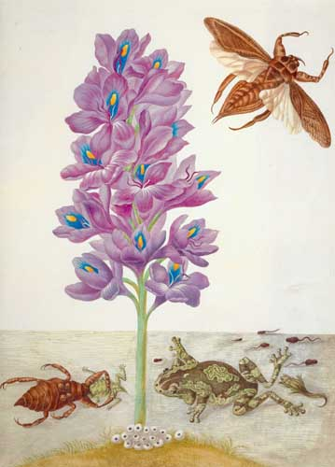
Maria Sibylla Merian

Slide 2
What can you see?
Slide 1

Slide 3
What else can you see?
Slide 2

Slide 4
To observe means to look closely. Look really closely at the next slide. What do you observe?
Slide 3

Slide 5
Slide 4

Slide 6
Slide 5

Slide 7
Q - How many different insects can you see?
A – one They are all cockroaches at the different stages of the lifecycle – instars.
Slide 6

Slide 8
Observe the drawings carefully. Use what you can see to match it to the photo of the same species.
Slide 7

Slide 9
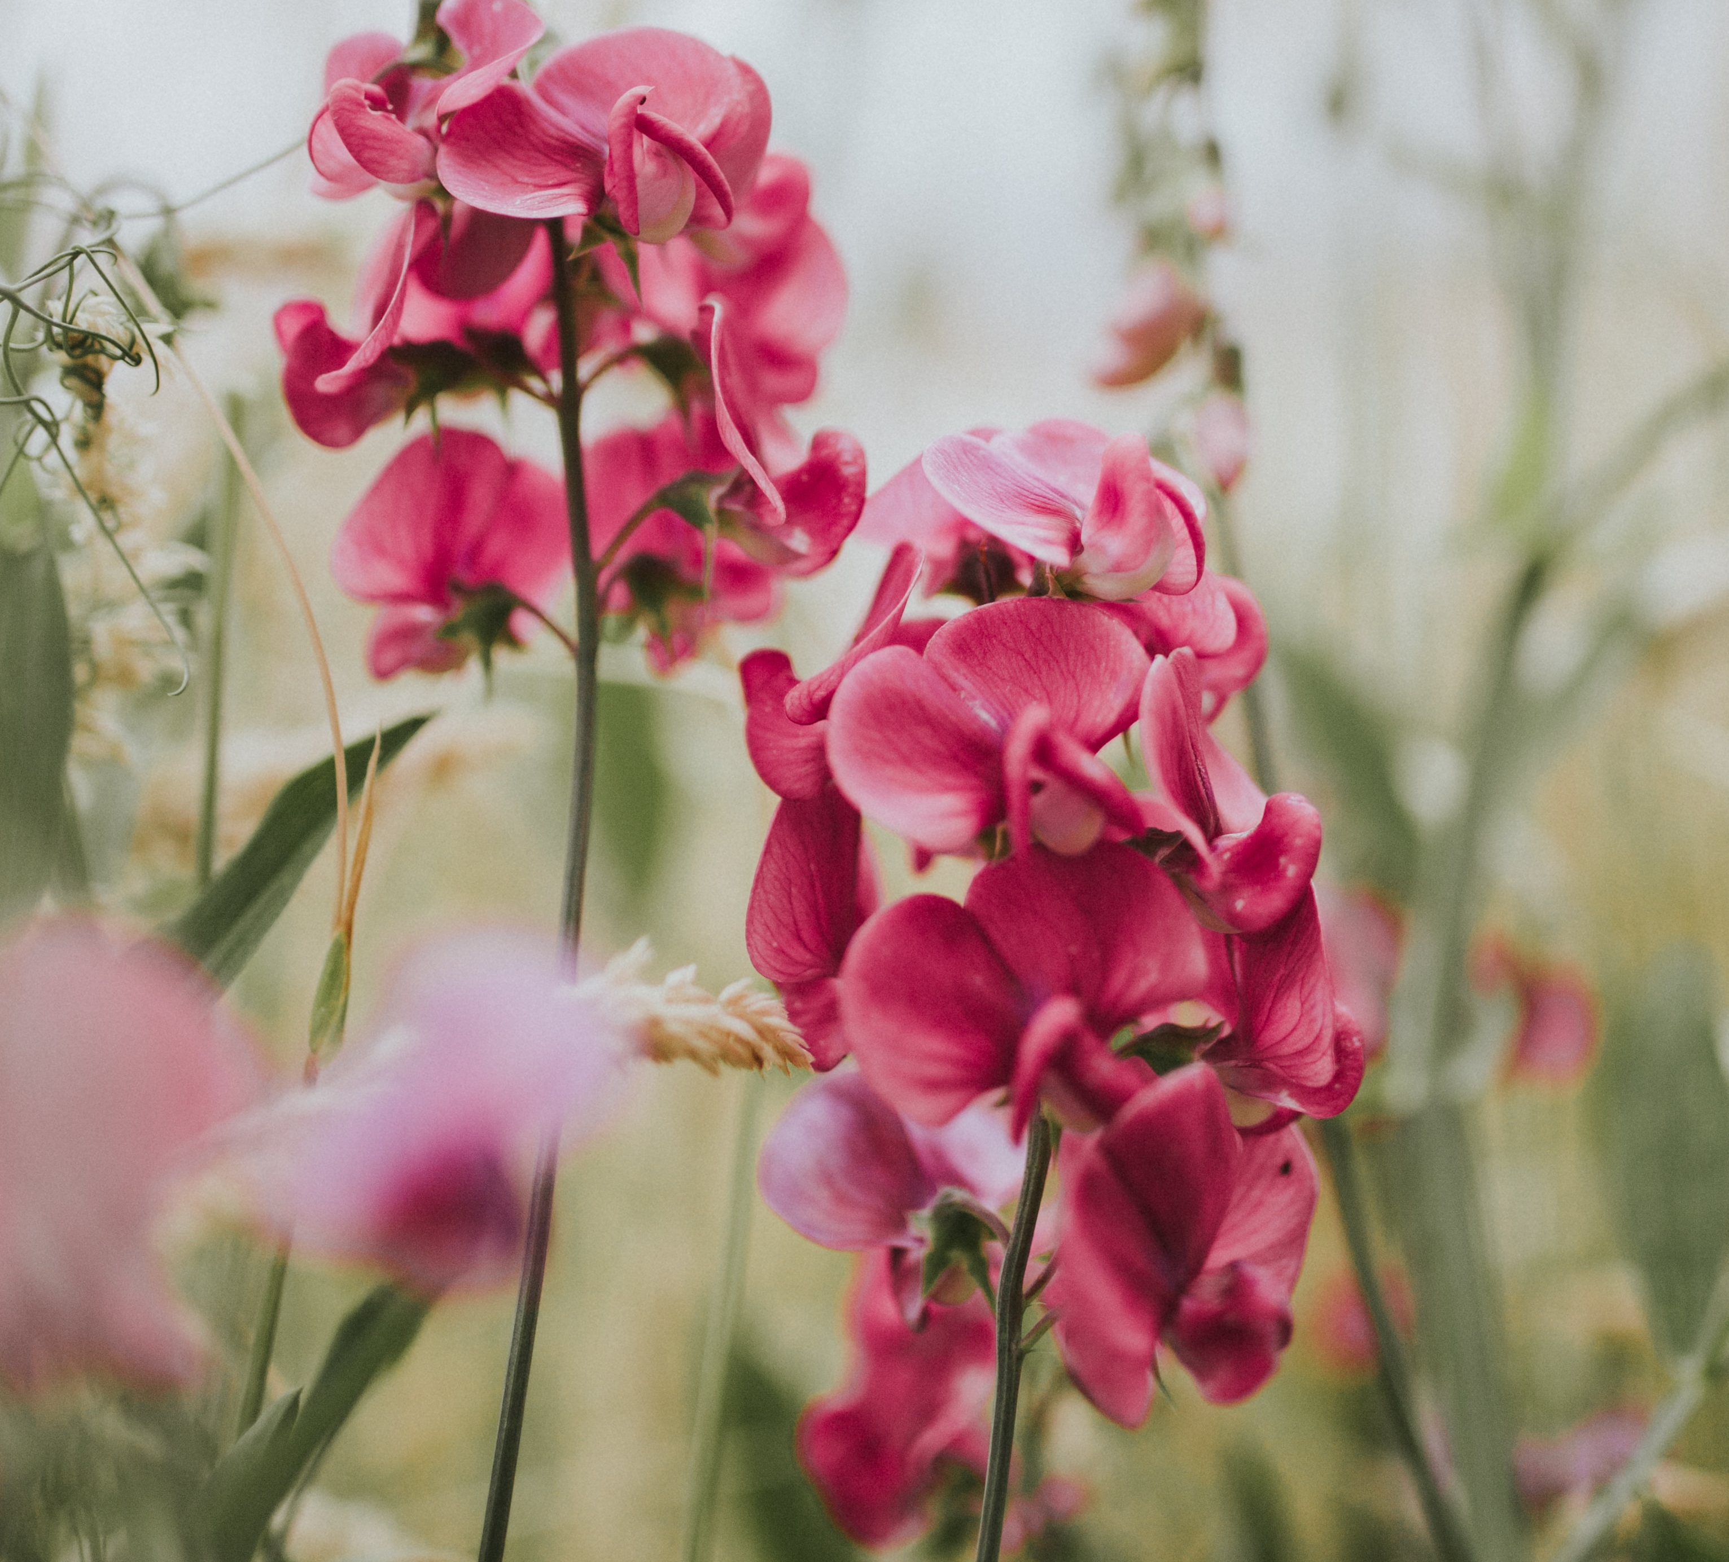
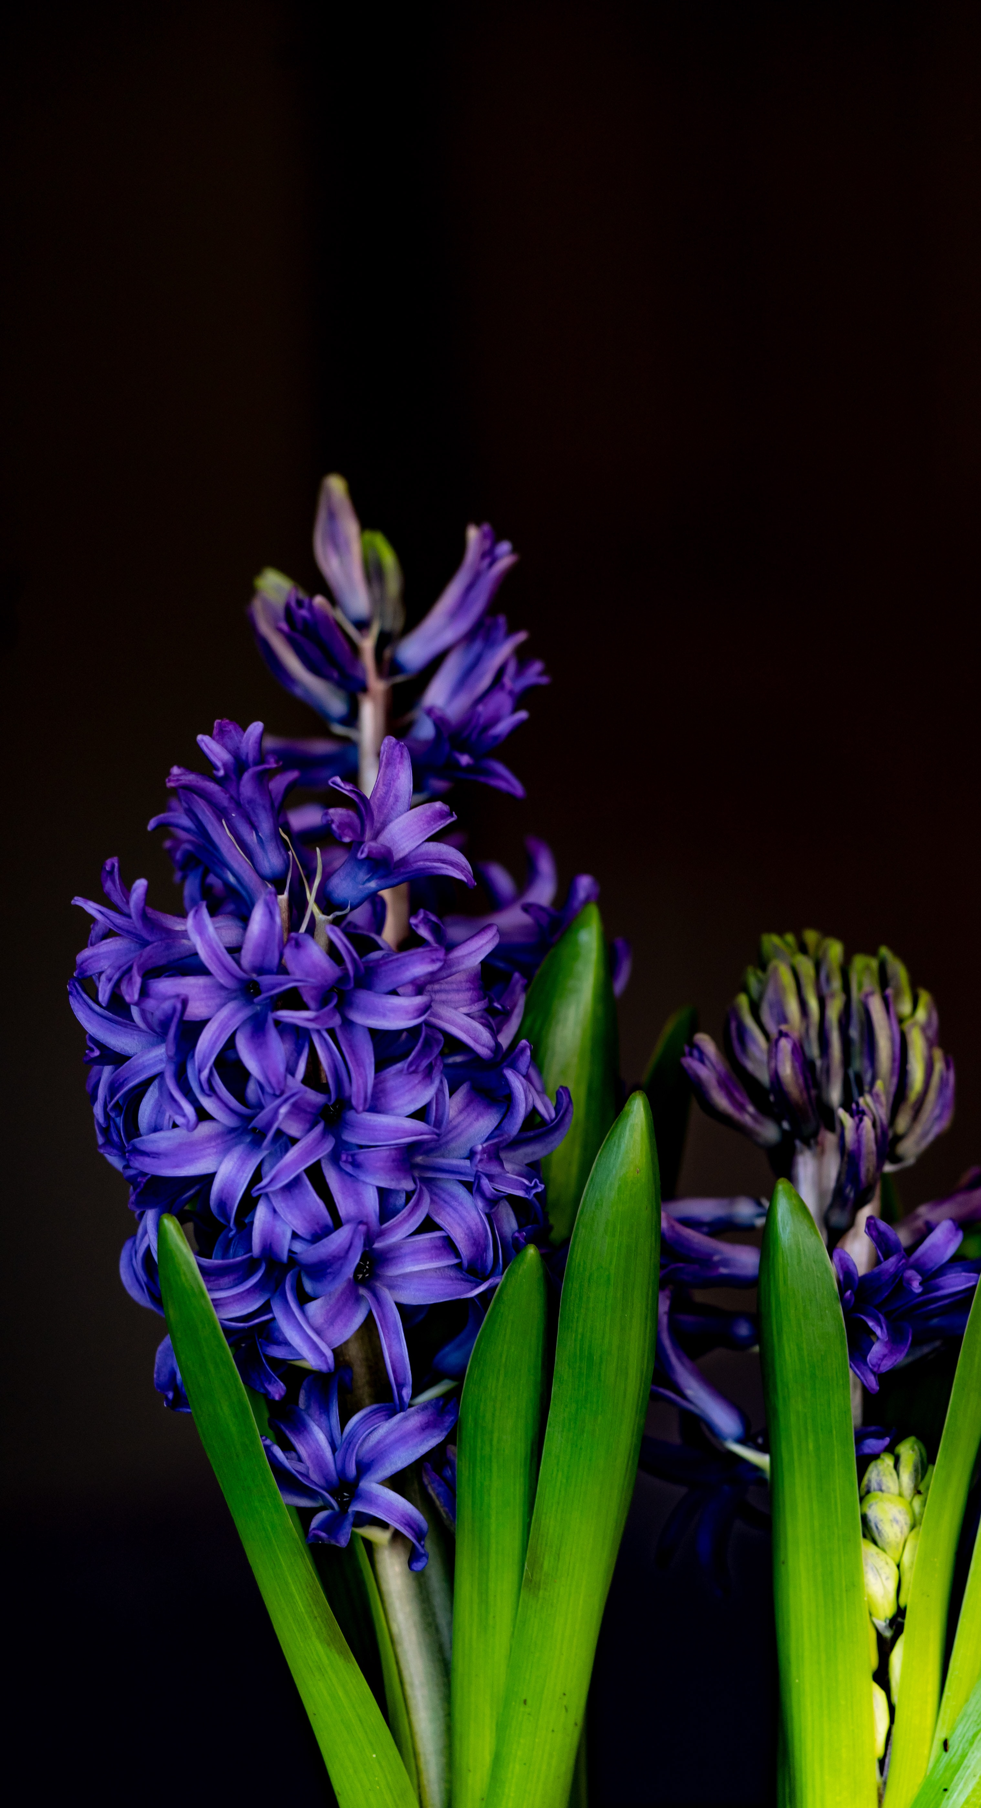
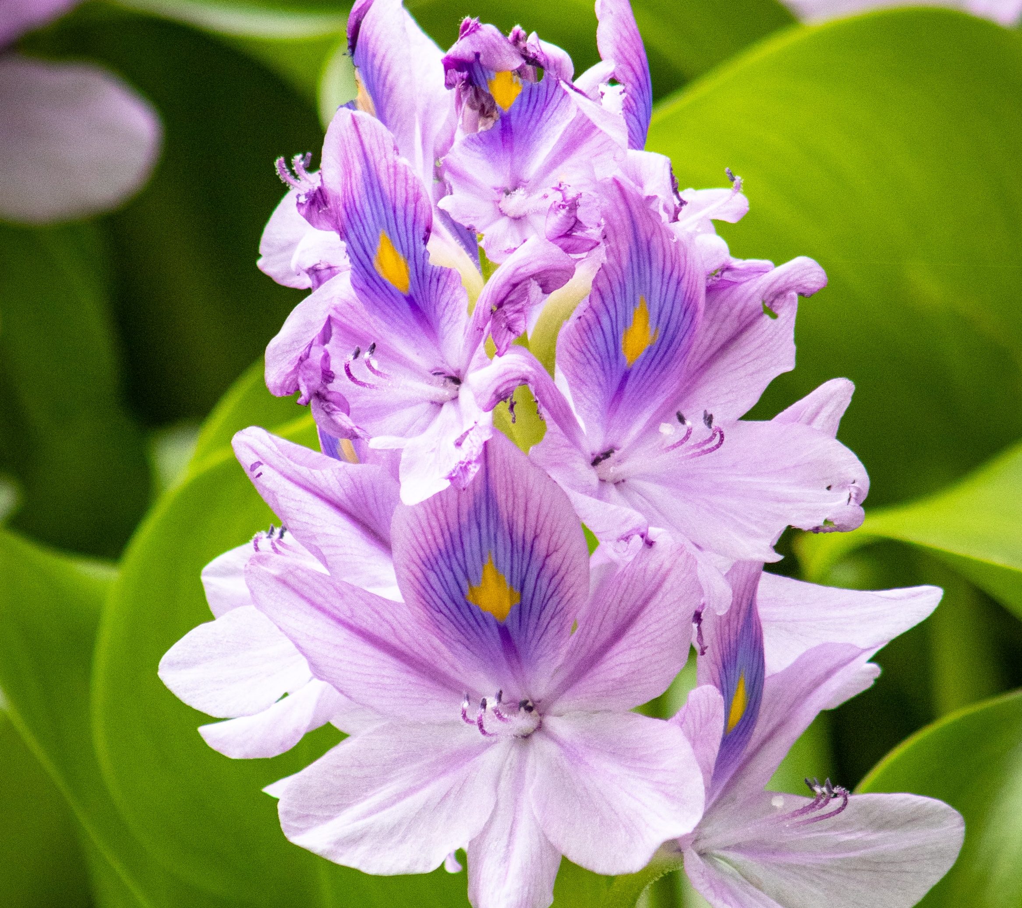
Slide 8

Slide 10
Slide 9

Slide 11
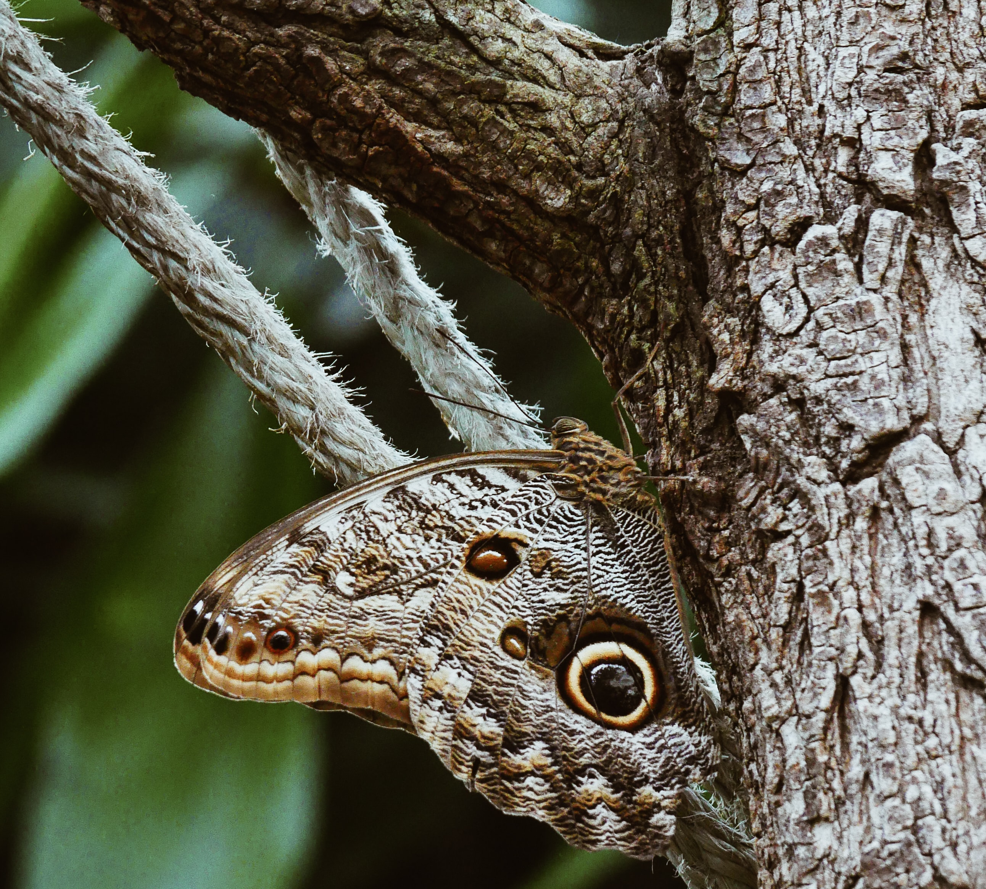
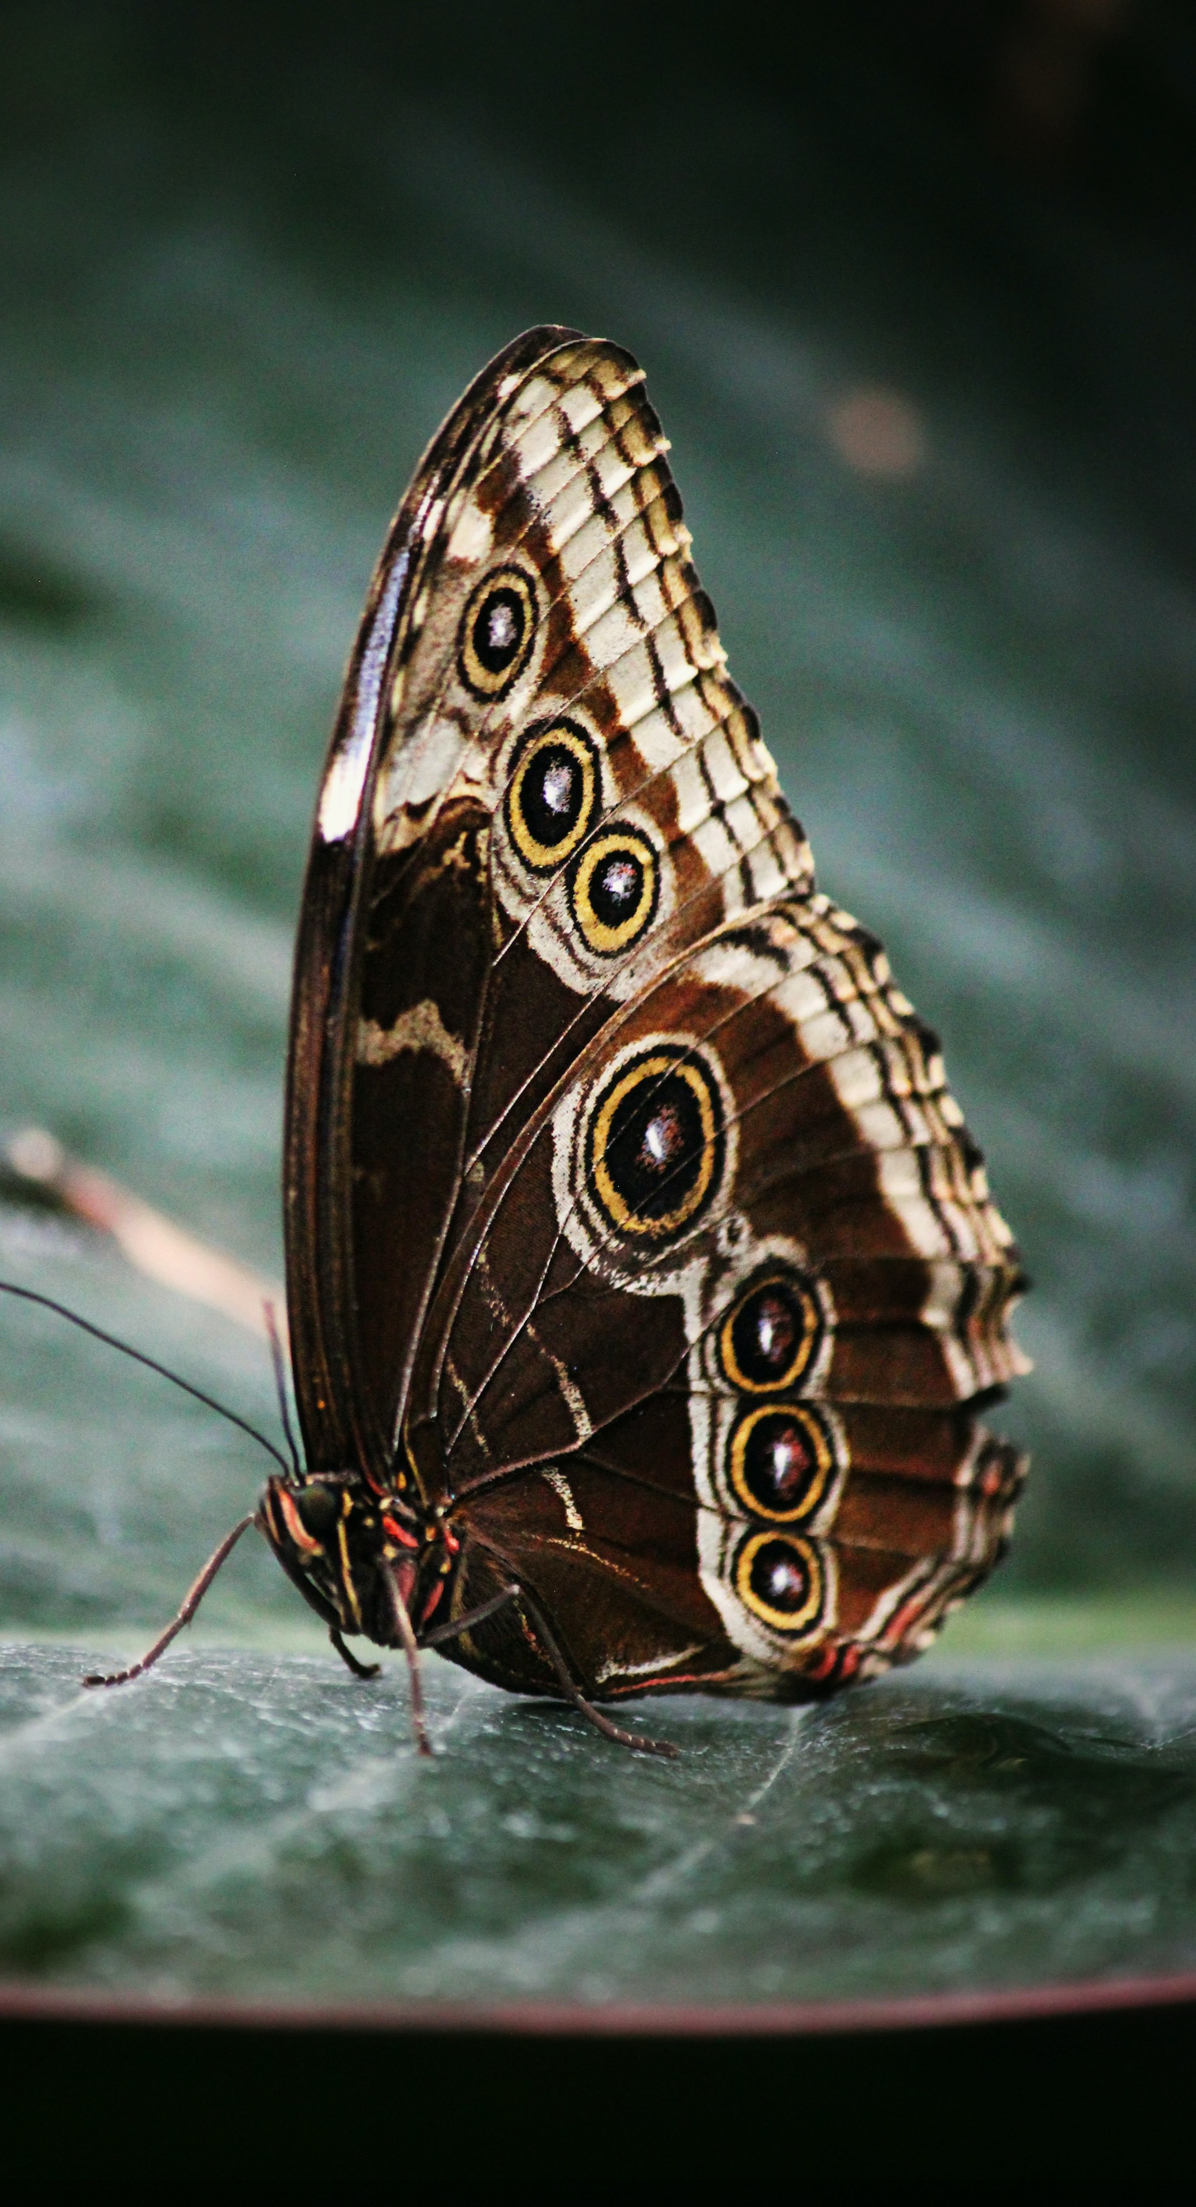
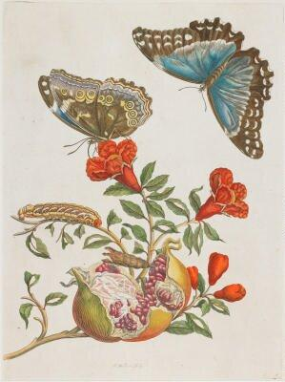
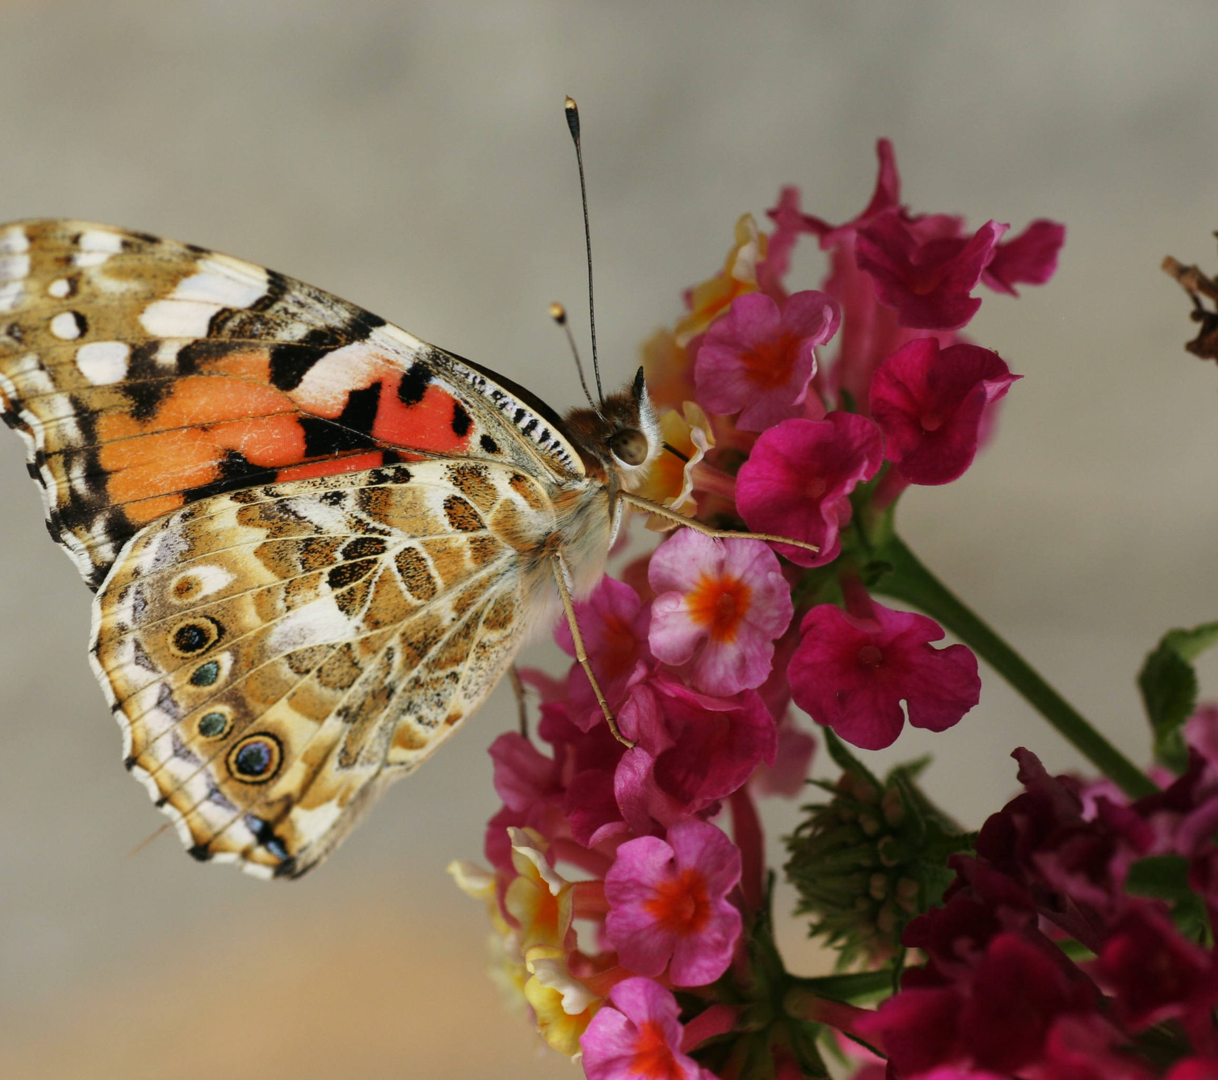
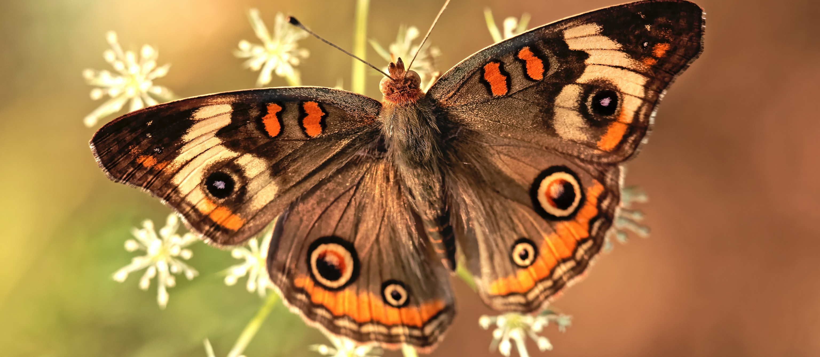
Slide 10

Slide 12
Slide 11

Slide 13
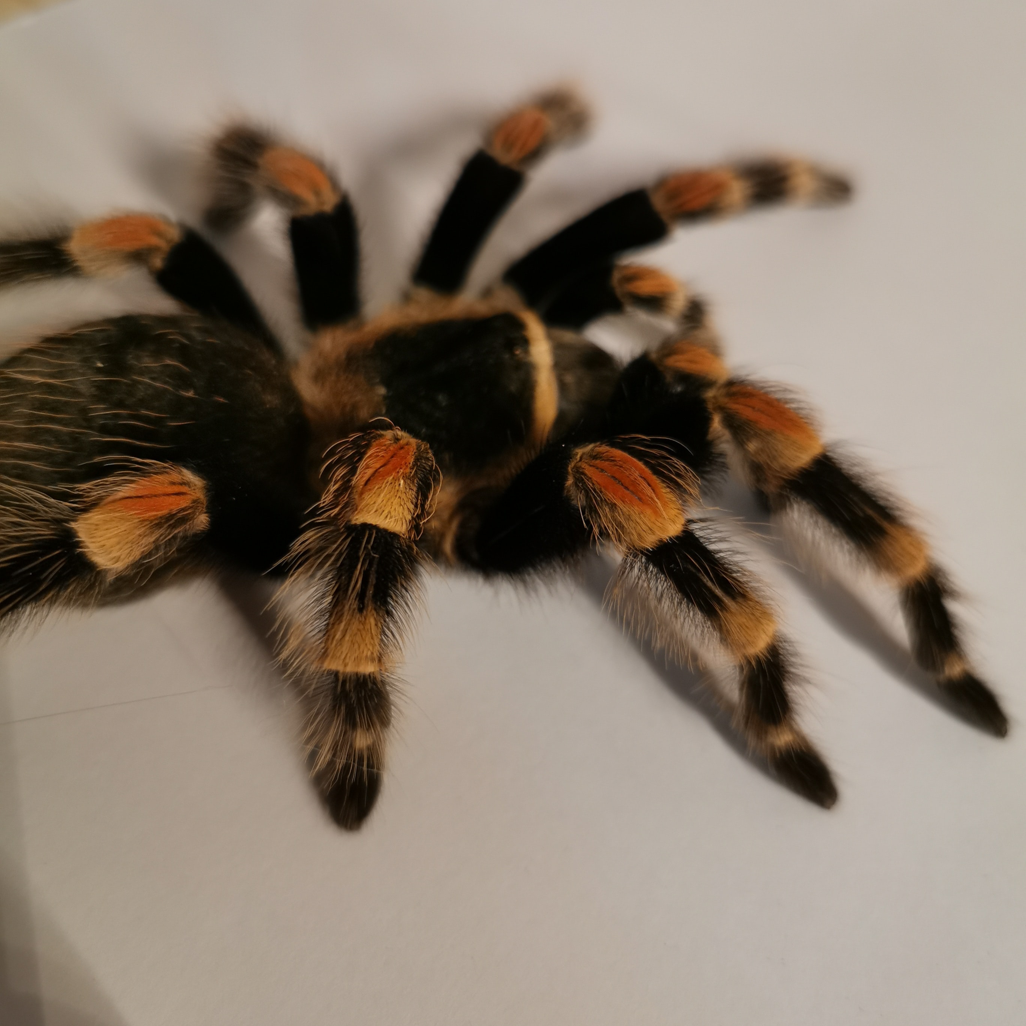
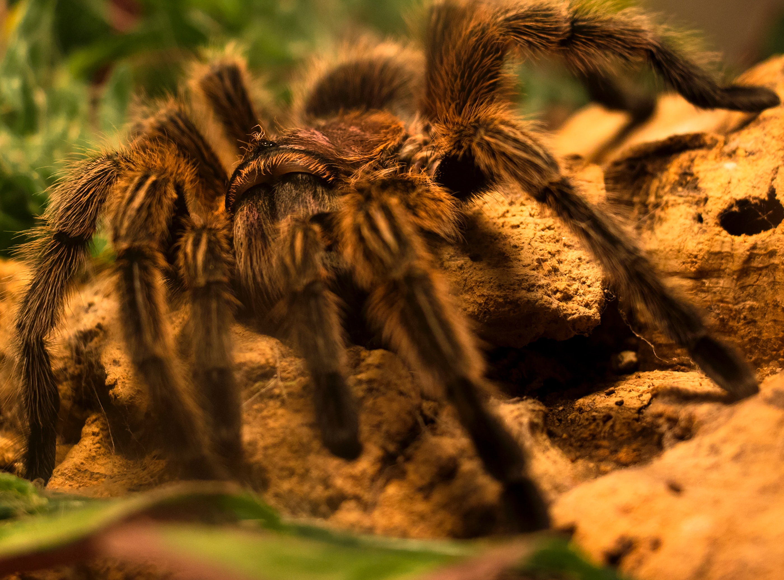
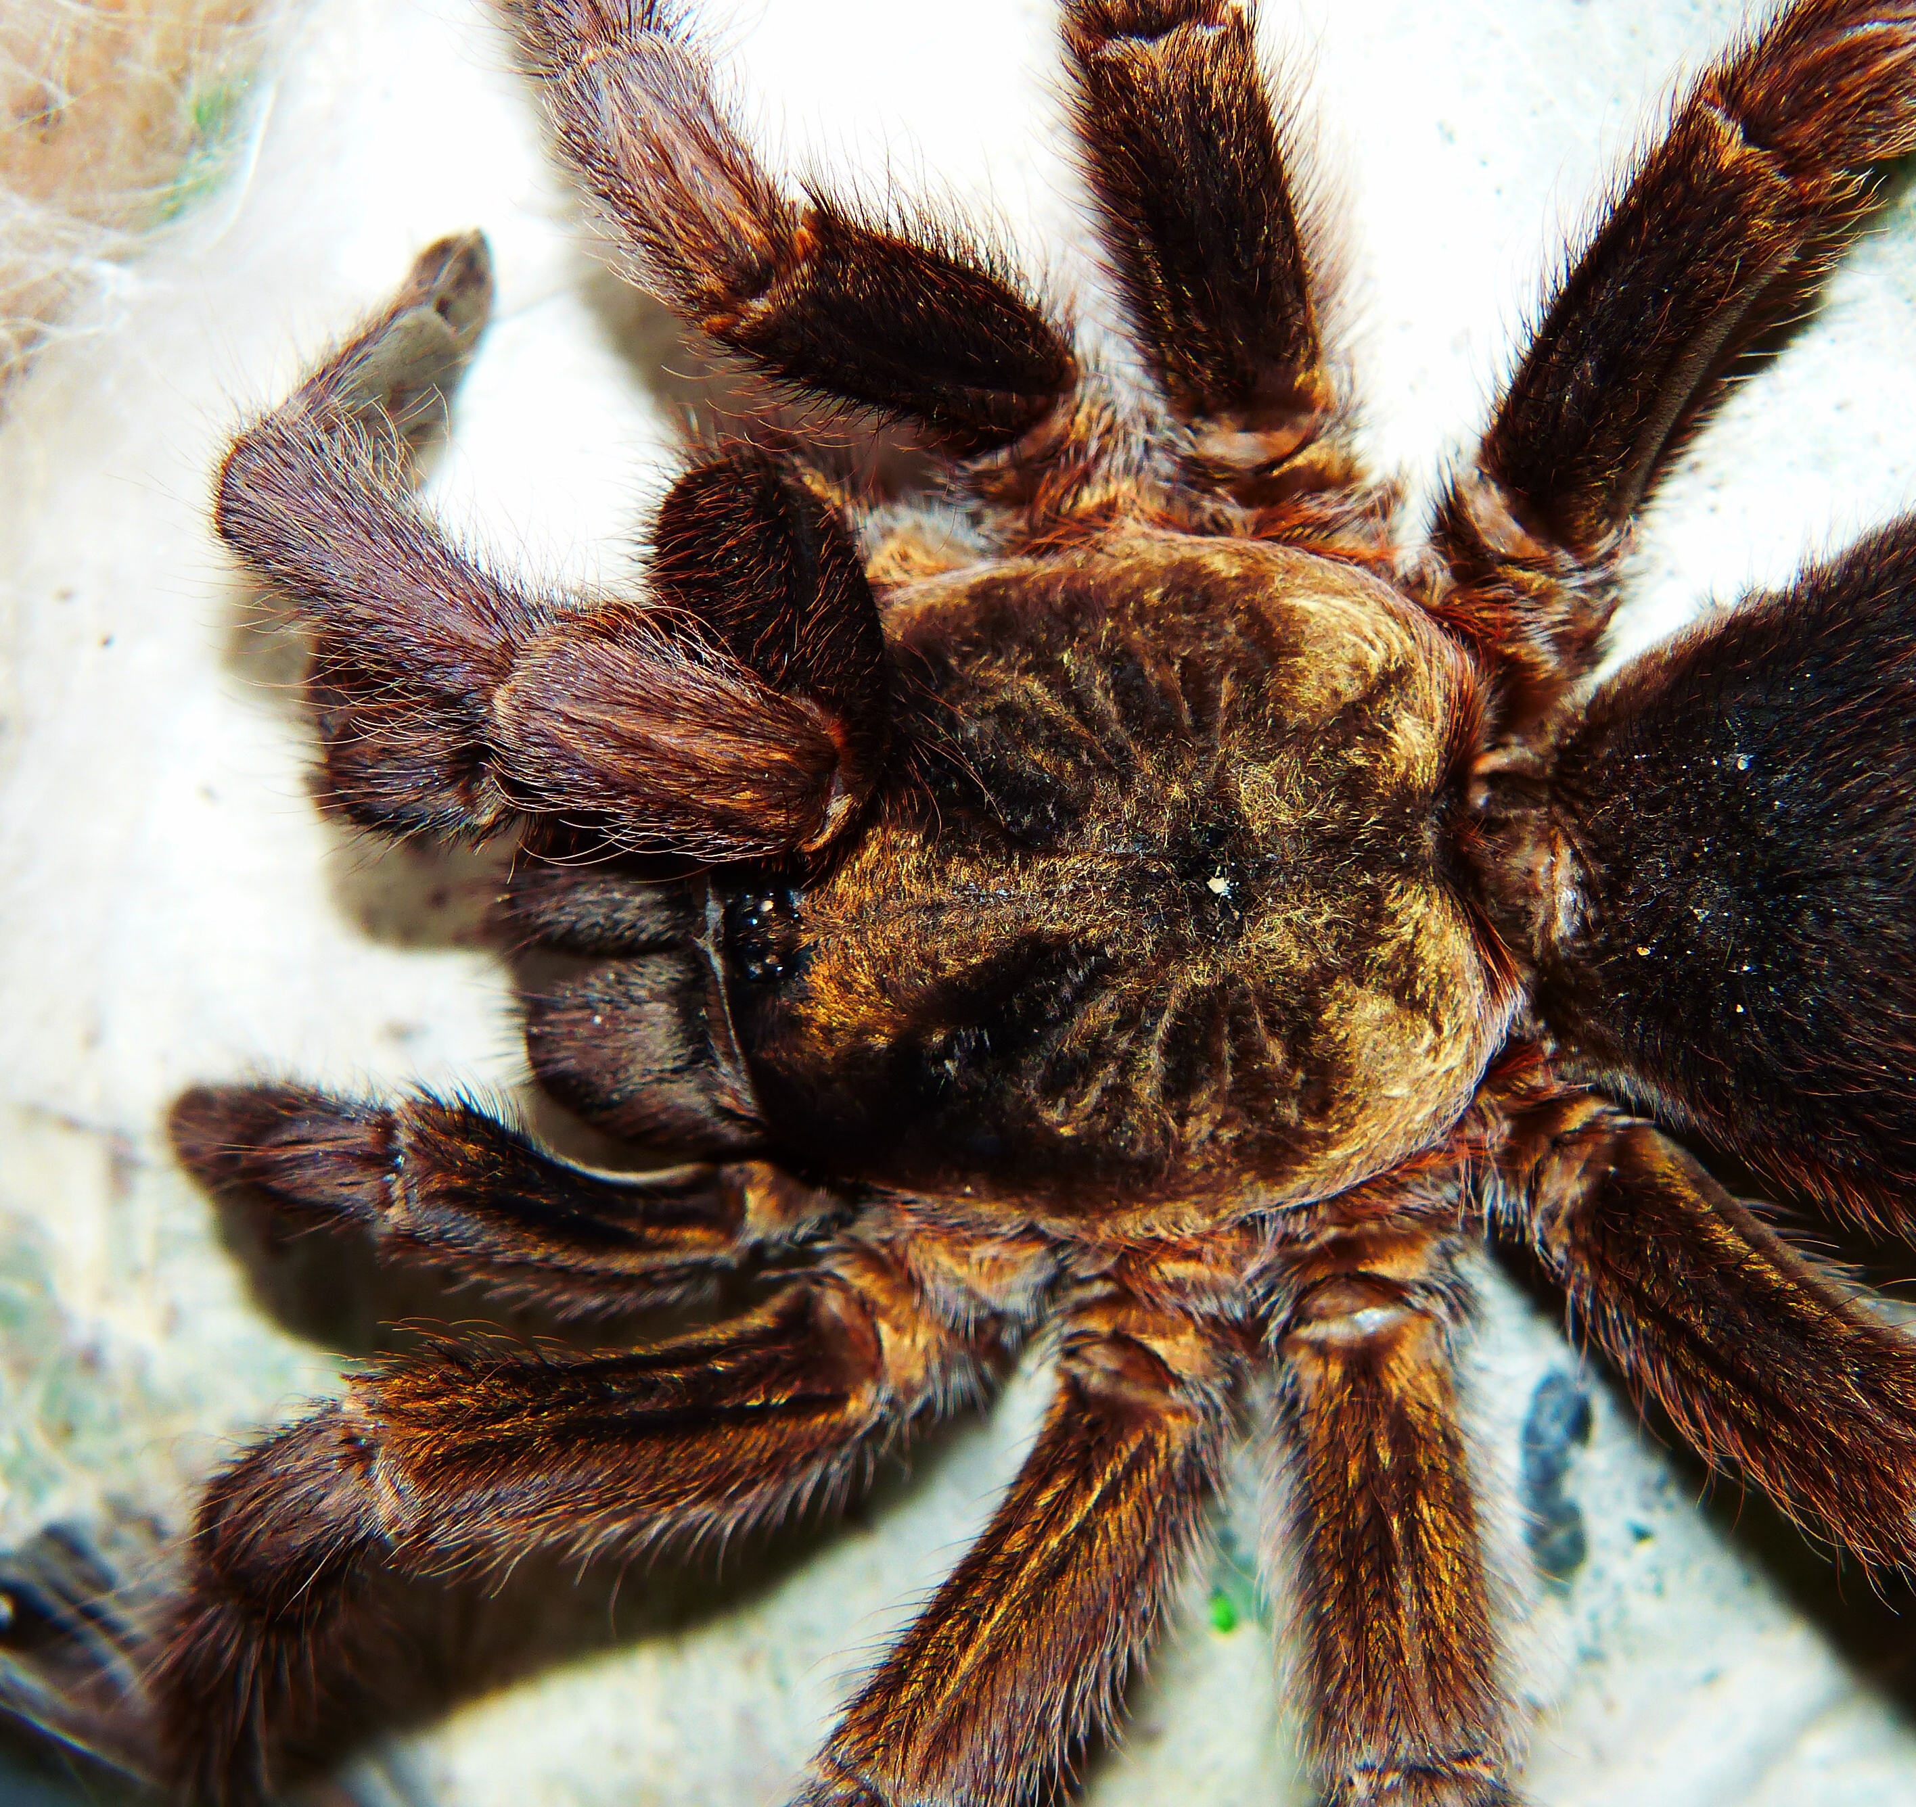
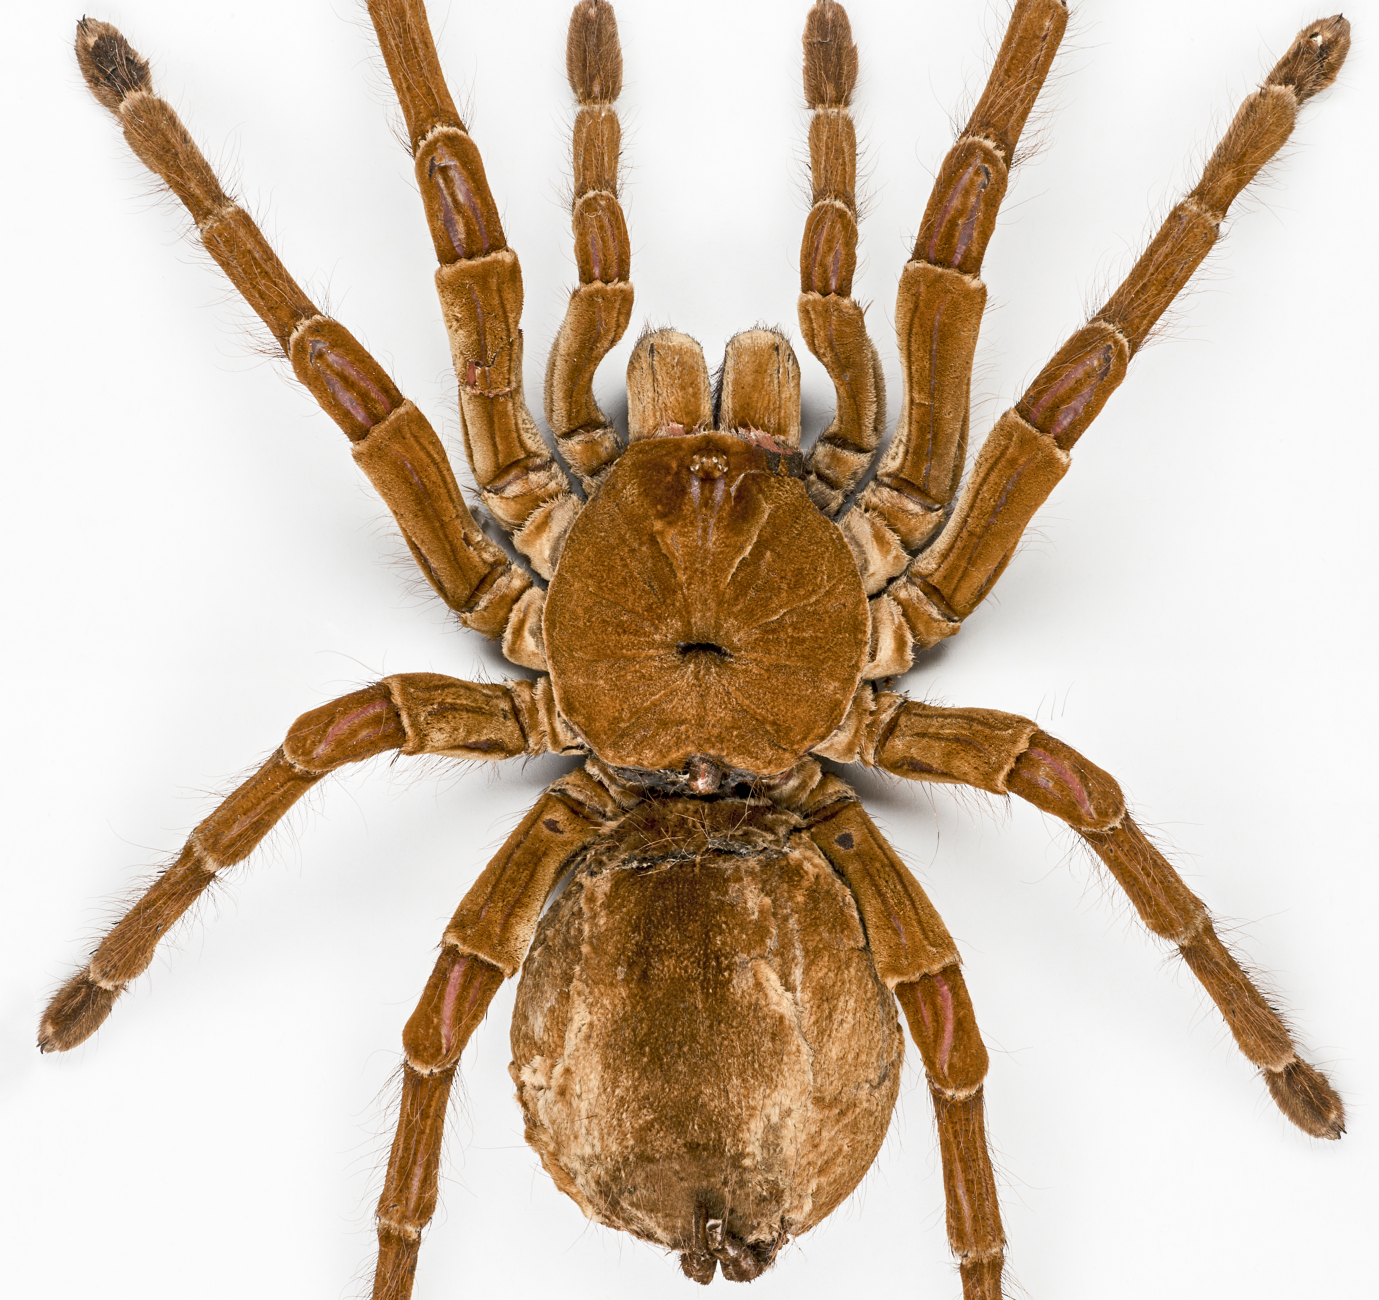
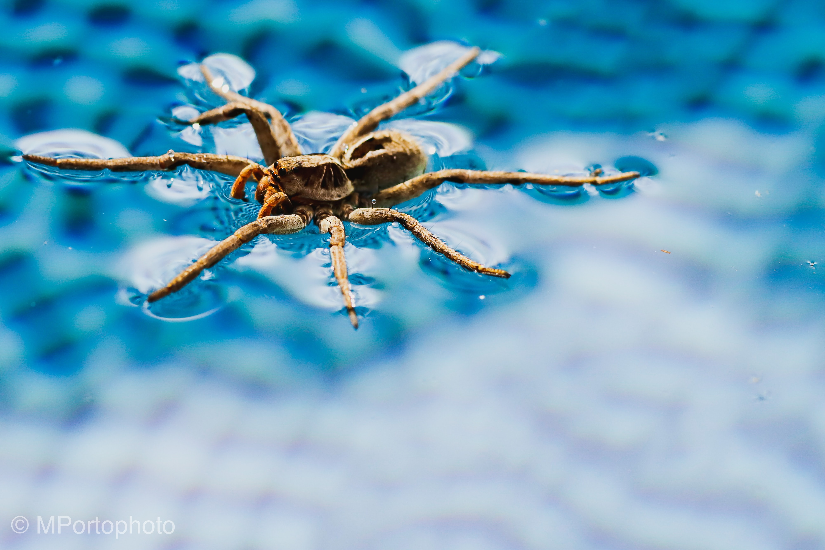
Slide 12

Slide 14
Slide 13

Slide 15
Photo Credits: Photos from Unsplash Images of Maria’s drawings – public domain
© HMDT Music 2020

